Slide 1

LINEAR PROGRAMMING
Dr. Zhenyu He
Shenzhen Graduate School, Harbin Institute of Technology
Autumn 2015

Slide 2
A Political Problem
Policy | urban | suburban | rural
Build roads | -2 | 5 | 3
Gun control | 8 | 2 | -5
Farm subsidies | 0 | 0 | 10
Gasoline tax | 10 | 0 | -2
The effect of policies on voters.

Slide 3
We format this problem as
minimize
subject to

Slide 4
General linear programs
Linear equality
Linear inequality
or

Slide 5

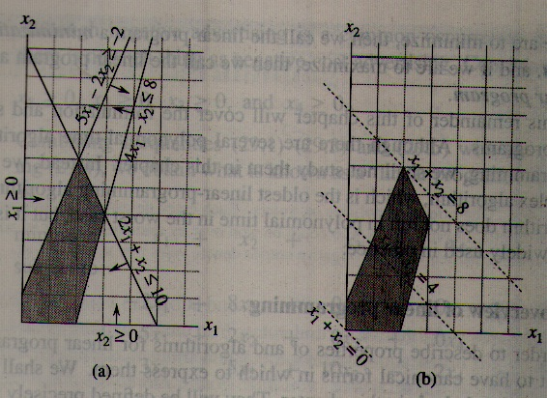




Considering one linear program with two variables
maximize
Subject to

Slide 6
Although we cannot easily graph linear programs with more than two variables, the same intuition holds.
If we have three variables, then each constraint is described by a half-space in three dimensional space. The intersection of these half-space froms the feasible region.
If we have n variables, then each constraint is described by a half-space in n dimensional space. The intersection of these half-space froms the feasible region.

Slide 7





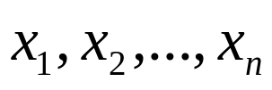
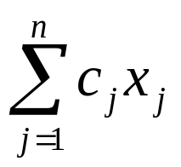
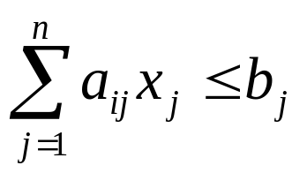
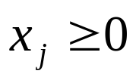
Standard Form
In standard form, we are given n real numbers ;
m real numbers ;
and mn real numbers for and ;
Finding n real numbers that
maximize
Subject to
for
for

Slide 8







This linear program can be rewritten as,
maximize
Subject to
where
A tuple (A, b, c) can represent a linear program in standard form.

Slide 9




Converting linear programs into standard form
For example, if we have the linear program ;
minimize
subject to

Slide 10

By negating the coefficients of the objective function, we get
maximize
subject to

Slide 11






To ensure that each variable has a non-negativity constraint, we have
maximize
subject to

Slide 12
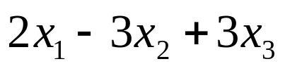
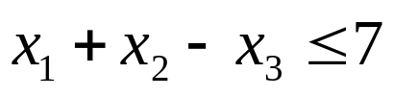
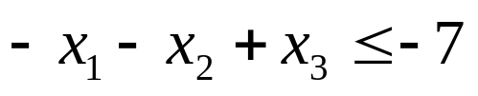
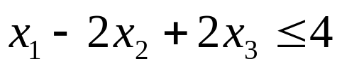
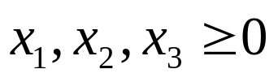
For consistency in variable names, we have
maximize
subject to

Slide 13
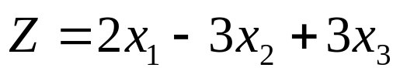
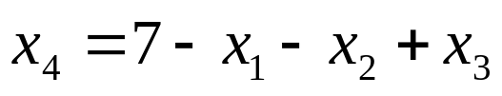
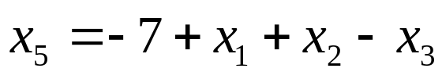
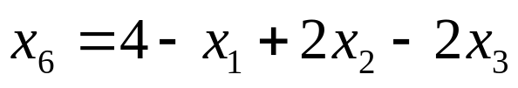
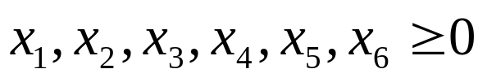
Converting linear programs into slack form
We introduce slack variables x₄ ,x₅ ,x₆, the linear programs we just discuessed can be written as
minimize
subject to

Slide 14



As in standard form, we use b_{i}, c_{j} and a_{ij} to denote constant terms and coefficients. Thus we can concisely define a slack form by a tuple (N, B, A, b, c, v) to denote the slack form
for
Here, the equations is indexed by B and the variables on the right-hand is indexed by N.

Slide 15






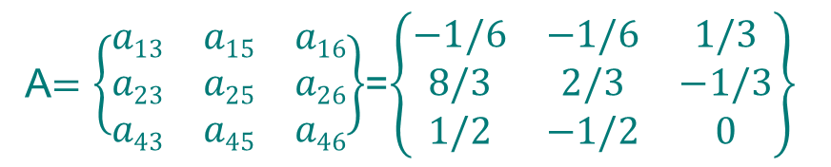
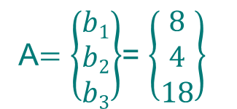


For example, in the slack form
We have

Slide 16
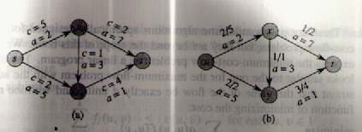
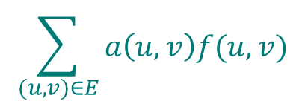




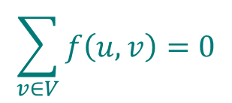

Minimum cost flow
maximize
subject to
for each
for each
for each

Slide 17





The simplex algorithm
Consider the following linear program in standard form:
maximize
subject to

Slide 18




In order to use the simplex algorithm, we must convert the linear program into slack form
maximize
subject to
This system has 3 equations and 6 variables, and therefore has an infinite number of solutions.
Basic solution:
If a basic solution is also feasible, we call it a basic feasible solution.

Slide 19






Since the third constraint is the tightest constraint, we switch x₁ and x₆.
The linear program is rewritten as
The operation is call pivot.
New basic solution:
New objective function

Slide 20
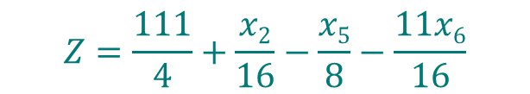



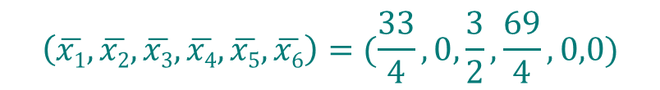

Since the third constraint is the tightest constraint again, we switch x₃ and x₅.
The linear program is rewritten as
New basic solution:
New objective function

Slide 21
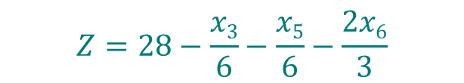




Now the only way to increase the objective value is to increase x₂.
The linear program is rewritten as
All coefficients in the objective function are negative, as means the basic solution is the optimal solution.
Basic solution(also optimal solution):
Objective function(also final solution)

